Slide 1
Strategic Management
Session 5
12th May, 2026

Slide 2
What is strategic management?
Strategic management is that set of managerial decisions and actions that determines the long-run performance of an organization.
It entails all of the basic management functions; that is, the organization's strategies must be planned, organized, put into effect, and controlled

Slide 3
Strategic management process
Step 1: Identifying the Organization's Current Mission, Objectives, and Strategies
Every organization needs a mission—a statement of the purpose of an organization. The mission answers the question: What is our reason for being in business? Defining the organization's mission forces managers to carefully identify the scope of its products or services

Slide 4
Components of a mission statement
Customers | Who are the organization's customers?
Products or services | What are the organization's major products or services?
Markets | Where does the organization compete geographically?
Technology | How technologically current is the organization?
Concern for survival, growth and profitability | Is the organization committed to growth and financial stability?
Philosophy | What are the organization's basic beliefs, values, aspirations, and ethical priorities?
Self-concept | What is the organization's major competitive advantage and core competencies?
Concern for public image? | How responsive is the organization to societal and environmental concerns
Concern for employees | Does the organization consider employees a valuable asset?

Slide 5
Step 2: Analyzing the Environment
Analyzing that environment is a critical step in the strategy process. Why? Because an organization's environment, to a large degree, defines management's options. A successful strategy will be one that aligns well with the environment
In analyzing the external environment, managers should examine both the specific and general environments to see what trends and changes are occurring
Step 2 of the strategic management process is complete when managers have an accurate grasp of what is taking place in the external environment and are aware of important trends that might affect the organization

Slide 6
Step 3: Identifying Opportunities and Threats
After analyzing the environment, managers need to assess what they have learned in terms of opportunities that the organization can exploit and threats it faces. Opportunities are positive trends in external environmental factors; threats are negative trends
Keep in mind that the same environment can present opportunities to one organization and pose threats to another in the same industry because of their different management of resources and capabilities

Slide 7
Step 4: Analyzing the Organization's Resources and Capabilities
What skills and abilities do the organization's employees have;
What resources does the organization have;
Has the organization been successful at innovating products;
What is the organization's financial position;
How do customers perceive the organization and the quality of its products or services?

Slide 8
The internal analysis provides important information about an organization's specific resources and capabilities. If any of these organizational capabilities or resources are exceptional or unique, they're called the organization's core competencies.
The core competencies are the organization's major value-creating skills, capabilities, and resources that determine the organization's competitive weapons

Slide 9
Step 5: Identifying Strengths and Weaknesses
The analysis in Step 4 should lead to a clear assessment of the organization's internal resources (such as financial capital, technical expertise, skilled workforce, experienced managers, and so forth).
It should also point out the organization's capabilities in performing the different functional activities (such as marketing, production and manufacturing, research and development, financial and accounting, information systems, human resources management, and so forth).
Any activities the organization does well or any unique resources that it has are called strengths. Weaknesses are activities the organization does not do well or resources it needs but does not possess

Slide 10
Managers should be aware that strong and weak cultures have different effects on strategy and that the content of a culture has a major effect on strategies pursued
An organization's culture is its personality. It reflects the shared values, beliefs, and valued behaviors that embody the "way things are done around here."
In a strong culture, almost all employees will have a clear understanding of what the organization is about. This clarity should make it easy for managers to convey to new employees the organization's core competencies and strengths.
The negative side of a strong culture, of course, is that it's more difficult to change. A strong culture may act as a significant barrier to accepting any changes in the organization's strategies

Slide 11
Organizational cultures also differ in the degree to which they encourage taking risks, exploiting innovations, and rewarding performance.
In a risk-aversive culture, for example, managers are likely to favor strategies that are defensive, that minimize financial exposure, and that react to changes in the environment rather than try to anticipate those changes. Conversely, where innovation is highly valued, managers are likely to favor new technology and product development.
Organizational culture also can promote or hinder an organization's strategic actions: What is a strategically appropriate culture? It's one that supports the firm's chosen strategy

Slide 12
The merging of Steps 3 and 5 results in an assessment of the organization's internal resources and capabilities and external environmental opportunities.
This is frequently called SWOT analysis because it's an analysis of the organization's strengths, weaknesses, opportunities, and threats.
Based on the SWOT analysis, managers can identify a strategic niche that the organization might exploit.

Slide 13
Step 6: Formulating Strategies
Strategies need to be established for the corporate, business, and functional levels of the organization
Managers need to develop and evaluate strategic alternatives and then select strategies that support and complement each other and that allow the organization to best capitalize on its strengths and environmental opportunities
Successful managers will choose strategies that give their organization the most favorable competitive edge, and then they will try to sustain that advantage

Slide 14
Step 7: Implementing Strategies
After strategies are formulated, they must be implemented. A strategy is only as good as its implementation. No matter how effectively an organization has planned its strategies, it can't succeed if the strategies aren't implemented properly.

Slide 15
Step 8: Evaluating Results
The final step in the strategic management process is evaluating results.
How effective have our strategies been?
What adjustments, if any, are necessary?

Slide 16
Intended, Emergent and Realized Strategies
An intended strategy is the strategy that an organization hopes to execute.
Intended strategies are usually described in detail within an organization’s strategic plan.
When a strategic plan is created for a new venture, it is called a business plan

Slide 17
An emergent strategy is an unplanned strategy that arises in response to unexpected opportunities and/or challenges.
Sometimes emergent strategies result in disasters
Emergent strategies can also lead to tremendous success
A realized strategy is the strategy that an organization actually follows.
Realized strategies are a product of a firm’s intended strategy (i.e., what the firm planned to do), the firm’s deliberate strategy (i.e., the parts of the intended strategy that the firm continues to pursue over time), and its emergent strategy (i.e., what the firm did in reaction to unexpected opportunities and challenges).

Slide 18
In other cases, firms’ original intended strategies are long forgotten. An unrealized strategy refers to the abandoned parts of the intended strategy

Slide 19
Types of Organizational Strategy
Corporate-Level Strategy: A corporate-level strategy seeks to determine what businesses a company should be in or wants to be in.
Corporate-level strategy determines the direction that the organization is going and the roles that each business unit in the organization will play in pursuing that direction

Slide 20
Grand Strategy—Stability
A stability strategy is a corporate-level strategy characterized by an absence of significant change.
Examples of this strategy include continuing to serve the same clients by offering the same product or service, maintaining market share, and sustaining the organization's return-on-investment results.
When should managers pursue stability? When they view the organization's performance as satisfactory and the environment appears to be stable and unchanging; that is, the organization is content to continue what it has been doing and sees no reason to change

Slide 21
Grand Strategy—Growth
The growth strategy is a corporate-level strategy that seeks to increase the level of the organization's operations.
This includes increasing such popular quantitative measures as sales revenues, number of employees, and market share.
Growth can be achieved through direct expansion, vertical integration, horizontal integration, or diversification

Slide 22
Growth through direct expansion (also called concentration) is achieved by internally increasing a firm's sales, production capacity, or workforce.
No other firms are acquired or merged with; instead the company chooses to grow by itself through its own business operations.

Slide 23
A company might also choose to grow by vertical integration, which is an attempt to gain control of inputs (backward vertical integration), outputs (forward vertical integration), or both.
In backward vertical integration, the organization attempts to gain control of its inputs by becoming its own supplier
In forward vertical integration, the organization gains control of its outputs (products or services) by becoming its own distributor

Slide 24
In horizontal integration, a company grows by combining with other organizations in the same industry—that is, combining operations with competitors

Slide 25
Finally, an organization can grow through diversification, either related or unrelated.
Related diversification is when a company grows by merging with or acquiring firms in different but related industries
Unrelated diversification is when a company grows by merging with or acquiring firms in different and unrelated industries.

Slide 26
Grand Strategy—Retrenchment
A retrenchment strategy is a corporate-level strategy designed to address organizational weaknesses that are leading to performance declines
When an organization is facing performance problems, a retrenchment strategy helps it stabilize operations, revitalize organizational resources and capabilities, and prepare to compete once again

Slide 27
Corporate Portfolio Analysis
The first portfolio matrix—the BCG matrix—developed by the Boston Consulting Group, introduced the idea that an organization's businesses could be evaluated and plotted using a 2 × 2 matrix to identify which ones offered high potential and which were a drain on organizational resources.
The horizontal axis represents market share, which was evaluated as either low or high; and the vertical axis indicates anticipated market growth, which also was evaluated as either low or high.
Based on its evaluation, the business was placed in one of four categories

Slide 28
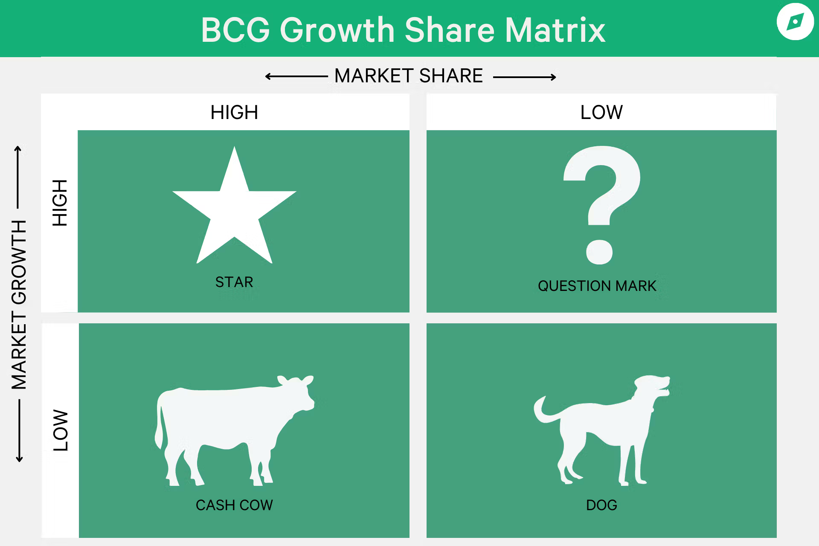
BCG Matrix

Slide 29
Cash cows (low growth, high market share). Businesses in this category generate large amounts of cash, but their prospects for future growth are limited.
Stars (high growth, high market share). These businesses are in a fast-growing market and hold a dominant share of that market. Their contribution to cash flow depends on their need for resources.
Question marks (high growth, low market share). These businesses are in an attractive industry but hold a small market share percentage.
Dogs (low growth, low market share). Businesses in this category do not produce or consume much cash. They have a low market share in a low-growth industry.

Slide 30
What are the strategic implications of the BCG matrix?
Managers should "milk" cash cows for as much as they can, limit any new investment in them, and use the large amounts of cash generated to invest in stars and question marks with strong potential to improve market share.
Heavy investment in stars will help take advantage of the market's growth and help maintain high market share. The stars, of course, will eventually develop into cash cows as their markets mature and sales growth slows.
The hardest decision for managers is related to the question marks. After close and careful analysis, some will be sold off and others turned into stars.
The dogs should be sold off or liquidated as they have low market share in markets with low growth potential

Slide 31
Business-Level Strategy
A business-level strategy seeks to determine how an organization should compete in each of its businesses.
For a small organization in only one line of business or the large organization that has not diversified into different products or markets, the business-level strategy typically overlaps with the organization's corporate strategy.
For organizations in multiple businesses, however, each division will have its own strategy that defines the products or services it will offer, the customers it wants to reach, and the like.

Slide 32
The Role of Competitive Advantage
Competitive advantage is what sets an organization apart, that is, its distinct edge.
That distinct edge comes from the organization's core competencies, which might be in the form of organizational capabilities—the organization does something that others cannot do or does it better than others can do it.

Slide 33
Competitive Strategies
Michael Porter (1980)
His competitive strategies framework identifies three generic strategies from which managers can choose.
Success depends on selecting the right strategy—one that fits the competitive strengths (resources and capabilities) of the organization and the industry it's in.
Porter's major contribution has been to carefully explain how managers can create and sustain a competitive advantage that will give a company above-average profitability.
An important element in doing this is an industry analysis.
Porter proposes that some industries are inherently more profitable (and, therefore, more attractive to enter and remain in) than others
In any industry, five competitive forces dictate the rules of competition. Together, these five forces determine industry attractiveness and profitability.
Managers assess an industry's attractiveness using the five factors

Slide 34
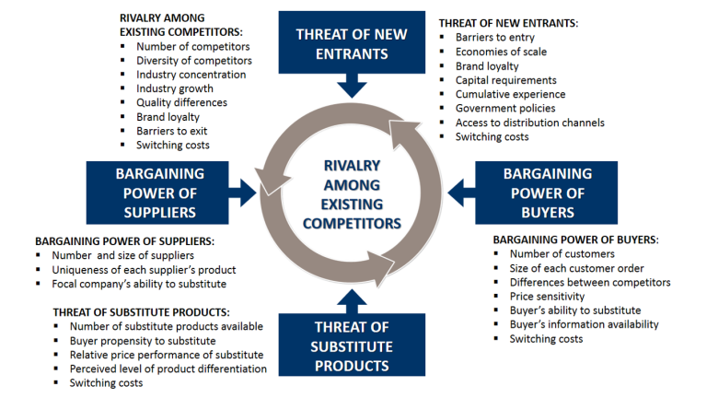

Slide 35
1. Threat of new entrants. Factors such as economies of scale, brand loyalty, and capital requirements determine how easy or hard it is for new competitors to enter an industry.
2. Threat of substitutes. Factors such as switching costs and buyer loyalty determine the degree to which customers are likely to buy a substitute product.
3. Bargaining power of buyers. Factors such as number of customers in the market, customer information, and the availability of substitutes determine the amount of influence that buyers have in an industry.
4. Bargaining power of suppliers. Factors such as the degree of supplier concentration and availability of substitute inputs determine the amount of power that suppliers have over firms in the industry.
5. Existing rivalry. Factors such as industry growth rate, increasing or falling demand, and product differences determine how intense the competitive rivalry will be among existing firms in the industry.

Slide 36
According to Porter, no firm can be successful by trying to be all things to all people.
He proposes that managers select a strategy that will give the organization a competitive advantage.
Porter goes on to say that a competitive advantage comes from either having lower costs than all other industry competitors or by being significantly different from competitors.
On that basis, managers can choose one of three strategies: cost leadership, differentiation, or focus. Which one managers select depends on the organization's strengths and core competencies and its competitors' weaknesses

Slide 37
Requirements for Successfully Pursuing Porter's Competitive Strategies
Generic Strategy | Commonly Required Skills and Resources | Common Organizational Requirements
Overall cost leadership | Sustained capital investment and access to capital Process engineering skills Intense supervision of labor Products designed for ease in manufacture Low-cost distribution system | Tight cost control Frequent, detailed control reports Structured organization and responsibilities Incentives based on meeting strict quantitative targets

Slide 38
Requirements for Successfully Pursuing Porter's Competitive Strategies
Generic strategy | Commonly Required Skills and Resources | Common Organizational Requirements
Differentiation | Strong marketing abilities Product engineering Creative flair Strong capability in basic research Corporate reputation for quality or technological leadership Long tradition in the industry or unique combination of skills drawn from other businesses Strong cooperation from channels | Strong coordination among functions in R&D, product development, and marketing Subjective measurement and incentives instead of quantitative measures Amenities to attract highly skilled labor, scientists, or creative people

Slide 39
Requirements for Successfully Pursuing Porter's Competitive Strategies
Generic Strategy | Commonly Required Skills and Resources | Common Organizational Requirements
Focus | Combination of the foregoing policies directed at the particular strategic target | Combination of the foregoing policies directed at the particular strategic target

Slide 40
When an organization sets out to be the lowest-cost producer in its industry, it's following a cost leadership strategy.
A low-cost leader aggressively searches out efficiencies in production, marketing, and other areas of operation.
Overhead is kept to a minimum, and the firm does everything it can to cut costs.

Slide 41
The company that seeks to offer unique products that are widely valued by customers is following a differentiation strategy.
Sources of differentiation might be exceptionally high quality, extraordinary service, innovative design, technological capability, or an unusually positive brand image.
The key to this competitive strategy is that whatever product or service attribute is chosen for differentiating must set the firm apart from its competitors and be significant enough to justify a price premium that exceeds the cost of differentiating.

Slide 42
However, the focus strategy aims at a cost advantage (cost focus) or a differentiation advantage (differentiation focus) in a narrow segment.
That is, managers select a market segment or group of segments in an industry and don't attempt to serve the broad market.
The goal of a focus strategy is to exploit a narrow segment of a market.
These segments can be based on product variety, type of end buyer, distribution channel, or geographical location of buyers

Slide 43
What happens if an organization is unable to develop a cost or differentiation advantage?
Porter uses the term stuck in the middle to describe those organizations, which find it very difficult to achieve long-term success.
Porter goes on to note that successful organizations frequently get into trouble by reaching beyond their competitive advantage and ending up stuck in the middle.

Slide 44
Functional-Level Strategy
A functional-level strategy seeks to determine how to support the business-level strategy.
For organizations that have traditional functional departments such as manufacturing, marketing, human resources, research and development, and finance, these strategies need to support the business-level strategy.

Slide 45
History of Strategic Management
Strategy in Ancient Times:
Sun Tzu’s The Art of War (500 BC) provides a classic handbook on military strategy with numerous business applications, such as the idea “to win without fighting is the best.”
Niccolò Machiavelli’s 1532 book The Prince offers clever recipes for success to government leaders.

Slide 46
Strategic Management As A Field of Study
In 1911, Taylor published The Principles of Scientific Management: Taylor stressed how organizations could become more efficient through identifying the “one best way” of performing important tasks
The acceptance of strategic management as a necessary element of business school programs took a major step forward in 1959. A widely circulated report created by the Ford Foundation recommended that all business schools offer a capstone course. The goal of this course would be to integrate knowledge across different business fields such as marketing, finance, and accounting to help students devise better ideas for addressing complex business problems

Slide 47
1980: Launch of Strategic Management Journal
1980: publication of Competitive Strategy: Techniques for Analyzing Industries and Competitors by Harvard professor Michael Porter
1995: launch of Amazon by founder Jeff Bezos was perhaps the pivotal event in creating internet based commerce
2005: Thomas Friedman’s The World Is Flat: A Brief History of the Twenty-First Century, Friedman argues that many of the advantages that firms in developed countries such as the United States, Japan, and Great Britain take for granted are disappearing

